Slide 1
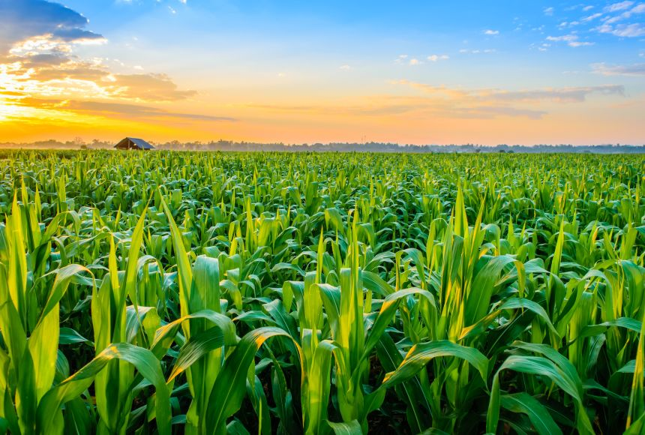
CROP RECOMMENDATION SYSTEM
SDG 2: ZERO HUNGER
Pranshu Yadav -422
Kartikey Lohani -446
Pushkala S R -448

Slide 2

ABSTRACT
In the crop recommendation application, the user can provide the soil data from their side and the application will predict which crop should the user grow.
For the fertilizer recommendation application, the user can input the soil data and the type of crop they are growing, and the application will predict what the soil lacks or has excess of and will recommend improvements.
For the last application, that is the plant disease prediction application, the user can input an image of a diseased plant leaf, and the application will predict what disease it is and will also give a little background about the disease and suggestions to cure it.

Slide 3
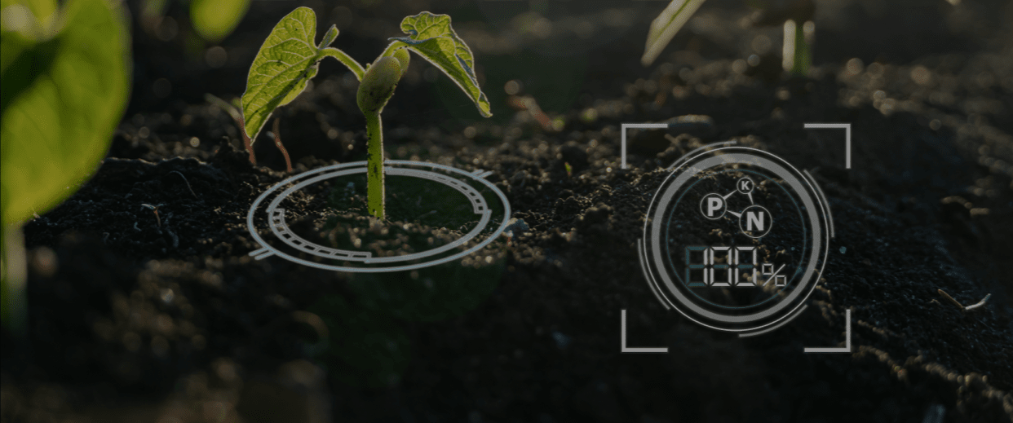
INTRODUCTION
Agriculture serves as the backbone of India's economy, employing a significant portion of its population and contributing substantially to its GDP. However, the sector faces numerous challenges, including fluctuating environmental conditions, diminishing arable land, and the need for sustainable practices to meet the demands of a growing population. In recent years, advancements in technology, particularly in the fields of Machine Learning (ML) and Deep Learning (DL), have presented promising solutions to address these challenges and enhance agricultural productivity.
ZERO HUNGER (SDG 2):
By recommending suitable crops based on factors such as soil type, climate, and other environmental conditions, the system can contribute to increasing agricultural productivity and ensuring food security.

Slide 4
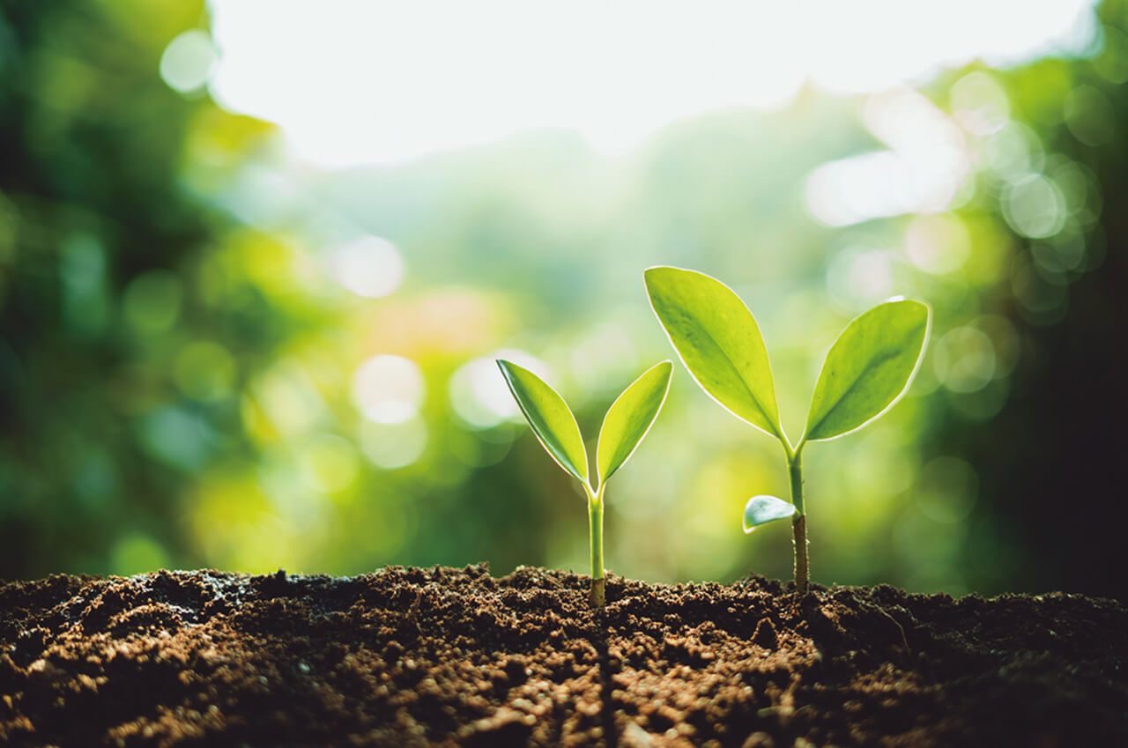
MOTIVATION
Farming is one of the major sectors that influences a country’s economic growth.
In country like India, majority of the population is dependent on agriculture for their livelihood. Many new technologies, such as Machine Learning and Deep Learning, are being implemented into agriculture so that it is easier for farmers to grow and maximize their yield.
Crop recommendation
Fertilizer recommendation
Plant disease prediction.

Slide 5

OBJECTIVE
Develop Crop Recommendation System:
Objective: To create an intelligent system that recommends suitable crops based on soil data provided by the user.
Key Tasks: Develop algorithms to analyze soil nutrient levels and correlate them with crop requirements. Implement a user-friendly interface for inputting soil data and displaying crop recommendations.
Implement Fertilizer Recommendation System:
Objective: To design a system that suggests appropriate fertilizers based on soil nutrient deficiencies and crop types.
Key Tasks: Develop algorithms to analyze soil nutrient levels and identify deficiencies or excesses. Integrate fertilizer databases to provide personalized recommendations for each user's soil conditions and chosen crops.
Build Plant Disease Detection System:
Objective: To develop an image recognition system capable of identifying plant diseases from uploaded images of diseased plant leaves.
Key Tasks: Train machine learning models on datasets of diseased and healthy plant images to recognize common diseases. Implement algorithms to analyze leaf images and provide accurate diagnoses along with treatment recommendations.

Slide 6
Integrate Weather Data for Enhanced Recommendations:
Objective: To incorporate weather data into crop and fertilizer recommendations for improved accuracy and relevance.
Key Tasks: Integrate weather APIs to fetch real-time or historical weather data for the user's location. Develop algorithms to consider weather conditions such as temperature, humidity, and precipitation in crop and fertilizer recommendations.
Scale and Deploy the System for Wide Adoption:
Objective: To deploy the agricultural technology platform for widespread use among farmers across India.
Key Tasks: Ensure scalability and reliability of the system to handle a large user base. Develop deployment strategies to reach farmers in remote areas with limited internet connectivity. Collaborate with agricultural organizations and government agencies to promote adoption and provide support for users.
Evaluate System Performance and User Satisfaction:
Objective: To assess the effectiveness and usability of the implemented systems through user feedback and performance metrics.
Key Tasks: Conduct usability testing with farmers to gather feedback on the website interface and recommendation accuracy. Measure system performance metrics such as prediction accuracy, response time, and user satisfaction scores.

Slide 7
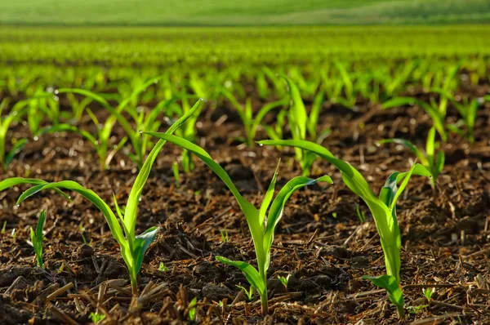
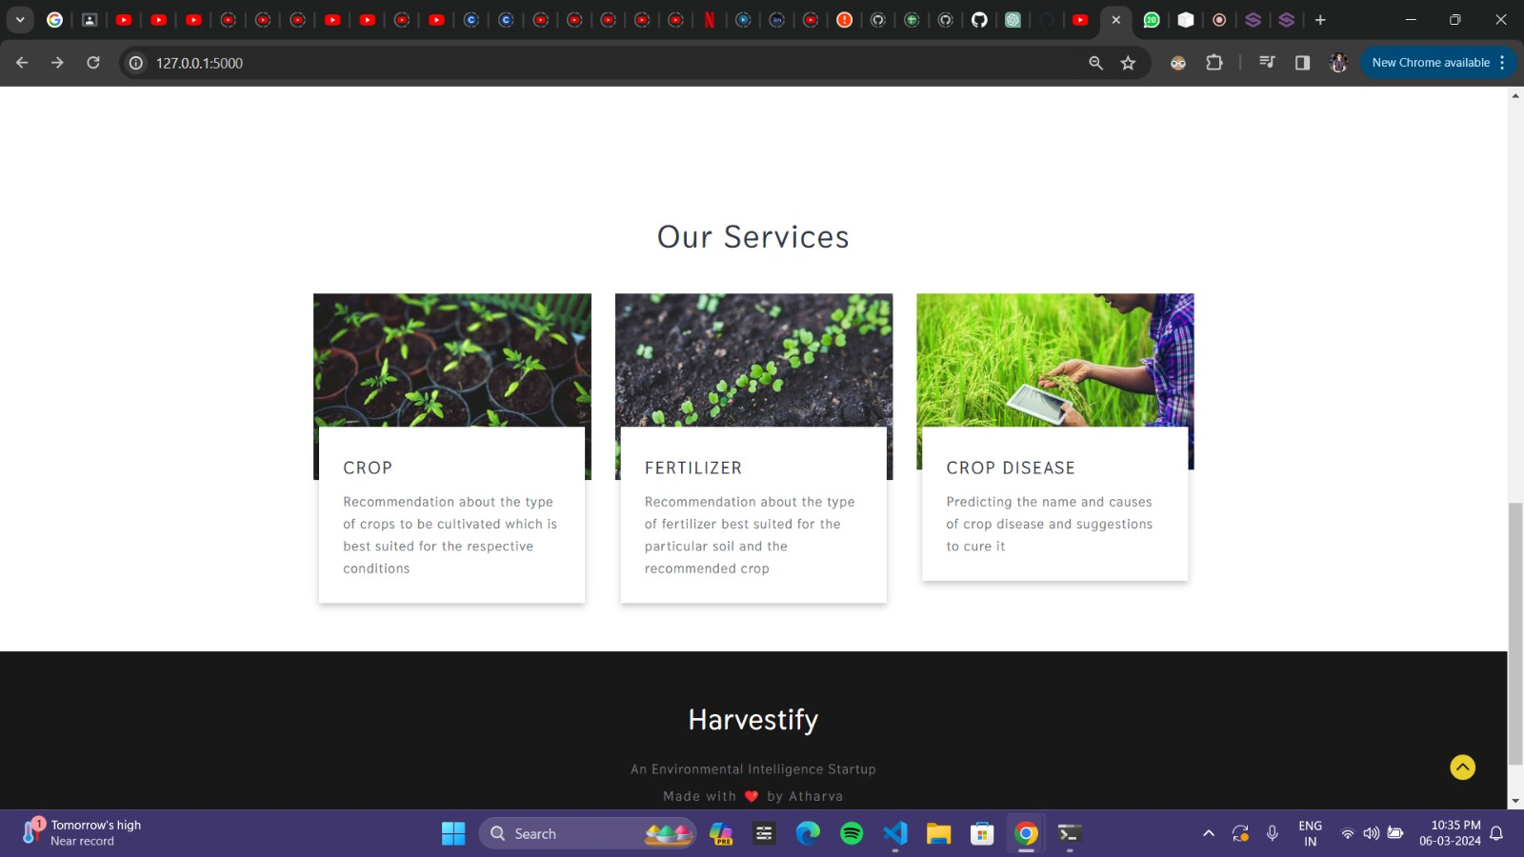

Slide 8

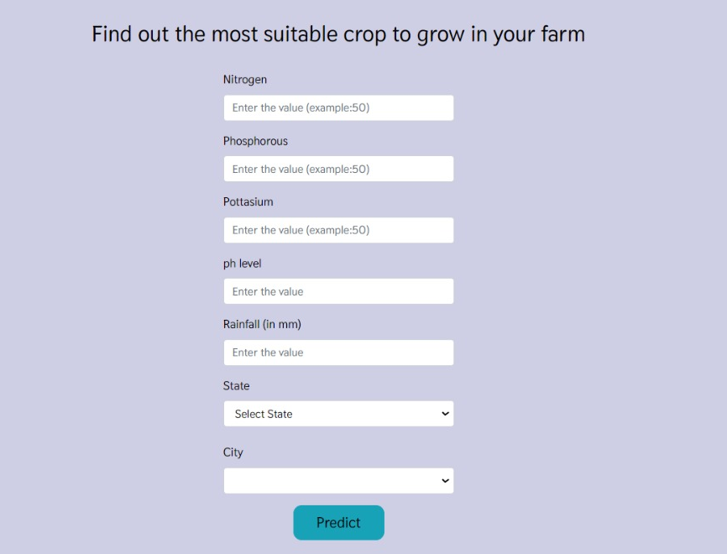
Crop Recommendation System

Slide 9
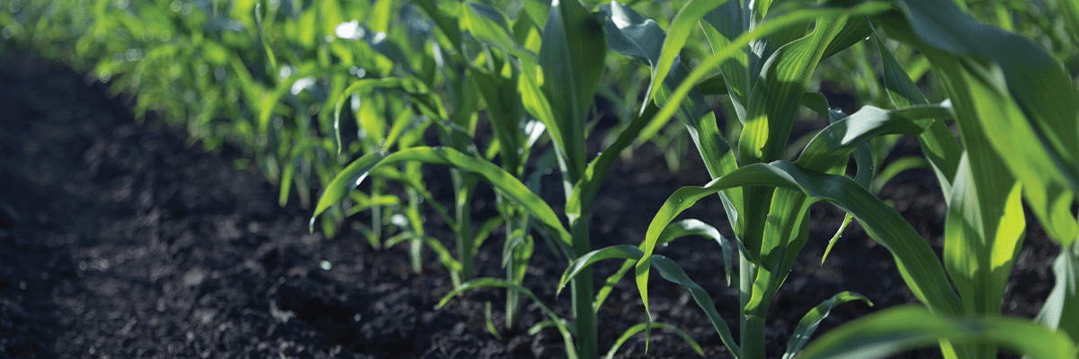
How to use?
CROP RECOMMENDATION SYSTEM:
Enter the corresponding nutrient values of your soil, state and city. Note that, the N-P-K (Nitrogen-Phosphorous-Pottasium) values to be entered should be the ratio between them.
FERTILIZER SUGGESTION SYSTEM:
Enter the nutrient contents of your soil and the crop you want to grow. The algorithm will tell which nutrient the soil has excess of or lacks. Accordingly, it will give suggestions for buying fertilizers.
DISEASE DETECTION SYSTEM:
Upload an image of leaf of your plant. The algorithm will tell the crop type and whether it is diseased or healthy. If it is diseased, it will tell you the cause of the disease and suggest you how to prevent/cure the disease accordingly.

Slide 10
